Slide 2
Database Architecture & HRP Data Dictionary

Slide 3
Course Objective
At the end of the course, you will be able to:
Understand
HRP Database Architecture - Important databases Used
HRP Data dictionary
Employee Induction
Leave
Time
Payroll
Reimbursement
Travel
Overview of PMS and Training Module
Tools to view dependencies
SQL Server Profiler
Model Explorer
Model Dependency viewer
Dependency Viewer Api

Slide 4
HRP Database Architecture
– Key Databases Used

Slide 5
HRP – Key Databases Used
HRMS40:
Is the application database
Contains HRP Application data
Holds Product Tables, views, User Defined Functions Synonyms for Temporary tables in HRMSTEMPDB and HRMSREPDB, Stored Procedures, and User Defined Data types
Release_history table in the HRMS40 database contains the CU version, Released Date and Deployed Date

Slide 6
HRP – Key Databases Used
HRMSTEMPDB:
Holds the Permanent Temporary Tables
Permanent Temporary table to contain a GUID column
GUID column should be indexed

Slide 7
HRP – Key Databases Used
Temp Tables : Purpose & Usage in Application:
To Process / Compute data and push the final data into transaction tables
In transactions the usage of temporary tables ensures that the online transaction processing time does not increase when the number of records in the main table goes to a very high number. As all required validations and other manipulations are done in temp table and in the main table only the insert / update done once finally
To Process the logic for any report requirement:
In Reports and Help Screen the temp table help in limiting the number of tables in the join condition and helps in progressive filtering of data based on the filter conditions provided
Data is moved to temporary tables before sending the output to reports in a Report Sp
To Process the search / get details logic for any screen

Slide 8
HRP – Key Databases Used
HRMSREPDB:
Holds the denormalized tables and views to be used for reports
DEPDB:
Is a RT database. Holds the context and Security information

Slide 9
HRP Data Dictionary

Slide 10
HRP Data Dictionary
System Manuals for every Module
Holding information about the tables under every module
Table Name
Brief description about the table
Columns in the table
Brief description on the data stored in a column
Column Datatype
User Defined data type associated with the column
Column Attributes
IS NULL
PK

Slide 11
Tools for Viewing Dependencies

Slide 12
Tools for Viewing Dependencies
SQL Server Profiler
Use Profiler to find the impacted objects for a task
Trace RPC_Completed event to generate the SP Level Trace
Trace SP_stmt_Completed event to generate the Line Level Trace
Model Explorer
Is used to connect to the Model database and view the design time specifications
Click on Preview to view the Solutioning Specifications
Click on Requirements Engineering to View the Business Rules and Message &Traversal Specifications
Click on Design Engineering to view the Design Engineering Specifications including Services, Process sections and methods, Business Terms and Design Errors

Slide 13
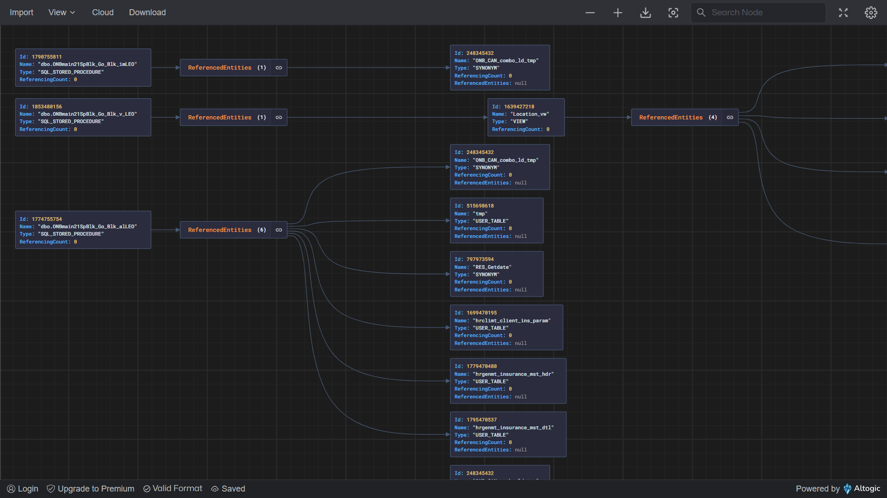
Tools for Viewing Dependencies
Platform Dependency Viewer
A comprehensive graphical representation provided to
visualize dependency object tree between modeled
stored procedures and the associated application
backend objects
Dependent entity types are
Stored Procedures
Functions
Tables
View
Synonym
The current scope is limited to the primary database exclusively. Entities spanning across multiple databases and servers are not addressed in this release.

Slide 14
Tools for Viewing Dependencies
Launching Applications
1. Platform model - Generate service screen
Usage Scenarios
1. Impact analysis - facilitating for identification of application objects associated with a given service
2. Static code analysis
Platform Dependency Viewer

Slide 15
Tools for Viewing Dependencies
Platform Dependency Viewer – Graph Viewer Capabilities
Zoom Out & Zoom In
Search text in graph nodes
Fullscreen mode
Rotate Layout – default orientation is horizontal
Expand / collapse nodes
Export data in JSON format

Slide 16
Tools for Viewing Dependencies
Platform Dependency Viewer
Planned Features (In-progress)
Dependency tree for Integration service
Deployment Prerequisite
VirtualWorks RT Release 2.10.0.0
VwApie RT Release 3.1.26

Slide 17
Tools for Viewing Dependencies
Platform Dependency Viewer – Full Screen View

Slide 18
Tools for Viewing Dependencies
Dependency Viewer Api
ENDPOINT_URL - http://<<model_server>>/coreapiops/Engineering/DesignEngineering/v1/platform/task
This is a get method. It will return the stored procedures for the selected task or service
ENDPOINT_URL - https://<<Application_Server>>/coreapiops/AppDBSchema/ApplnDependency/v1/referenced_entities
This is a Post method. It will return the referenced entities for the procedures given as input
ENDPOINT_URL - https://<<Application_server>>/coreapiops/AppDBSchema/ApplnDependency/v1/referencing_entities
This is a get method. For the procedure passed as input parameter, it will return the referencing entities (only stored Procedures)

Slide 19
Tools for Viewing Dependencies
Dependency Viewer Api
ENDPOINT_URL –
http://<<model_server>>/coreapiops/Engineering/DesignEngineering/v1/platform/sp_task
Used to perform Reverse impact analysis (Referencing entities) involves retrieving all the referencing entities and impacted services for a specified application backend object
This is a get method. It will return the service / task information from the model, for the procedure passed as parameter (input to be passed only as an array)

Slide 20
Summary of topic <topic Name>

